Slide 1
Topic 3 Entity-Relationship Modeling
Ir. Endang Ripmiatin, MT
Program Studi Teknik Informatika
Universitas Al Azhar Indonesia
Oktober 2017

Slide 2
Entity Sets
A database can be modeled as:
a collection of entities,
relationship among entities.
An entity is an object that exists and is distinguishable from other objects.
Example: specific person, company, event, plant
Entities have attributes
Example: people have names and addresses
An entity set is a set of entities of the same type that share the same properties.
Example: set of all persons, companies, trees, holidays

Slide 3
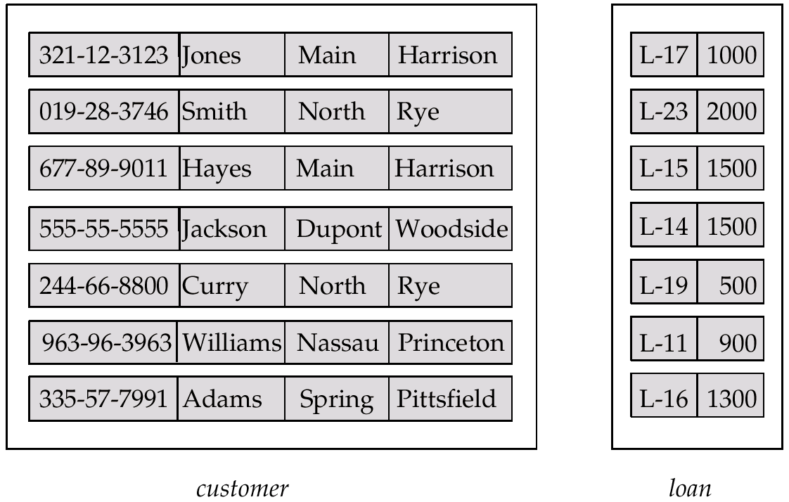
Entity Sets customer and loan
customer-id customer- customer- customer- loan- amount name street city number

Slide 4
Attributes
An entity is represented by a set of attributes, that is descriptive properties possessed by all members of an entity set.
Domain – the set of permitted values for each attribute
Attribute types:
Simple and composite attributes.
Single-valued and multi-valued attributes
E.g. multivalued attribute: phone-numbers
Derived attributes
Can be computed from other attributes
E.g. age, given date of birth
Example:
customer = (customer-id, customer-name, customer-street, customer-city)
loan = (loan-number, amount)

Slide 5
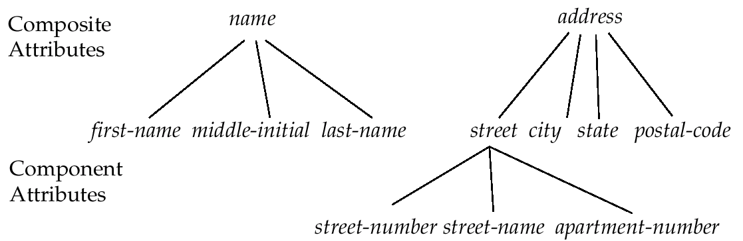
Composite Attributes

Slide 6
Relationship Sets
A relationship is an association among several entities
Example: Hayes depositor A-102 customer entity relationship set account entity
A relationship set is a set of relationship of the same type. It is mathematical relation among n ≥ 2 entities, each taken from entity sets
{(e₁, e₂, … e_{n}) | e₁ ∈ E₁, e₂ ∈ E₂, …, e_{n} ∈ E_{n}} where (e₁, e₂, …, e_{n}) is a relationship
Example:
(Hayes, A-102) ∈ depositor

Slide 7
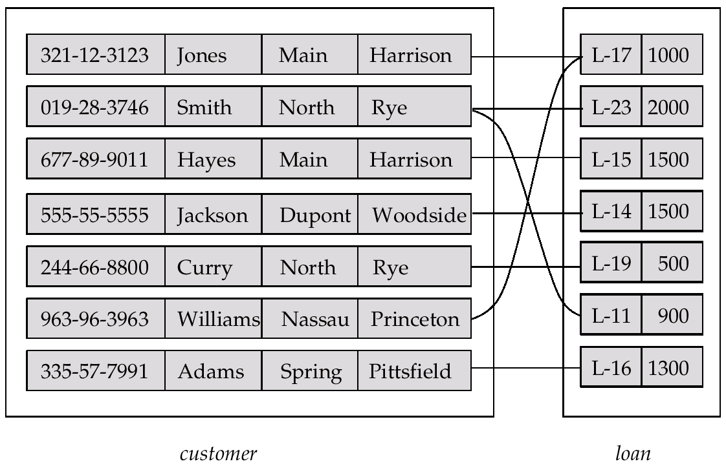
Relationship Set borrower

Slide 8
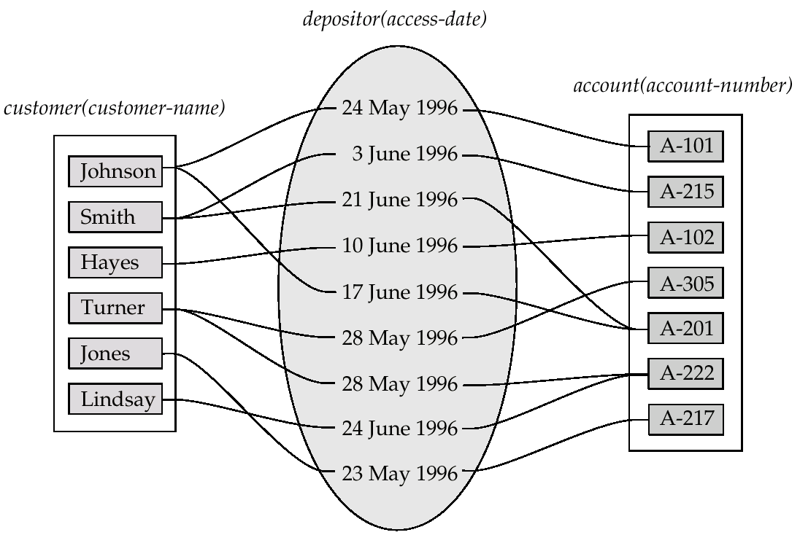
Relationship Sets (Cont.)
An attribute can also be property of a relationship set.
For instance, the depositor relationship set between entity sets customer and account may have the attribute access-date

Slide 9
Degree of a Relationship Set
Refers to number of entity sets that participate in a relationship set.
Relationship sets that involve two entity sets are binary (or degree two). Generally, most relationship sets in a database system are binary.
Relationship sets may involve more than two entity sets.
Relationships between more than two entity sets are rare. Most relationships are binary. (More on this later.)
E.g. Suppose employees of a bank may have jobs (responsibilities) at multiple branches, with different jobs at different branches. Then there is a ternary relationship set between entity sets employee, job and branch

Slide 10
Mapping Cardinalities
Express the number of entities to which another entity can be associated via a relationship set.
Most useful in describing binary relationship sets.
For a binary relationship set the mapping cardinality must be one of the following types:
One to one
One to many
Many to one
Many to many

Slide 11
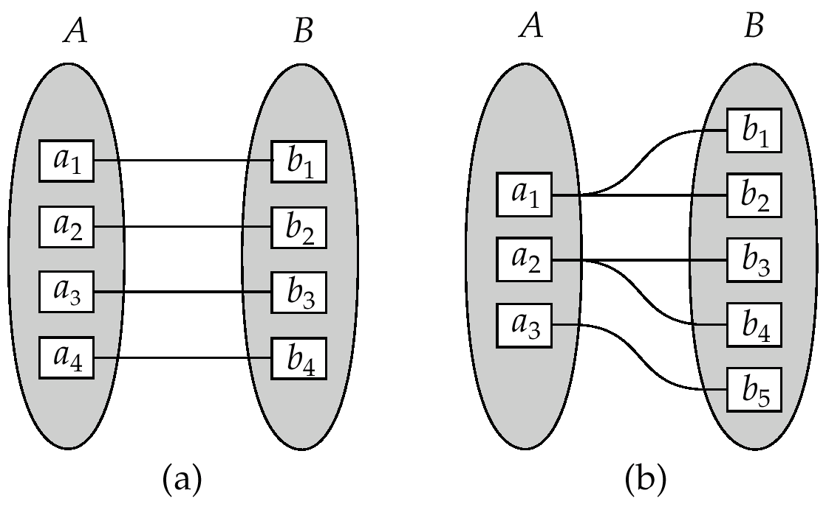
Mapping Cardinalities
One to one
One to many
Note:
Some elements in A and B may not be mapped to any elements in the other set

Slide 12
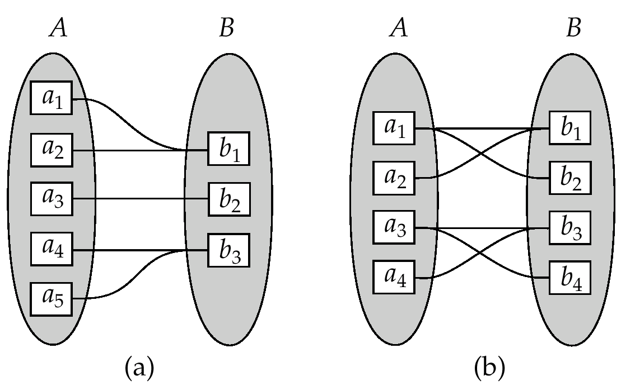
Mapping Cardinalities
Many to one
Many to many
Note:
Some elements in A and B may not be mapped to any elements in the other set

Slide 13
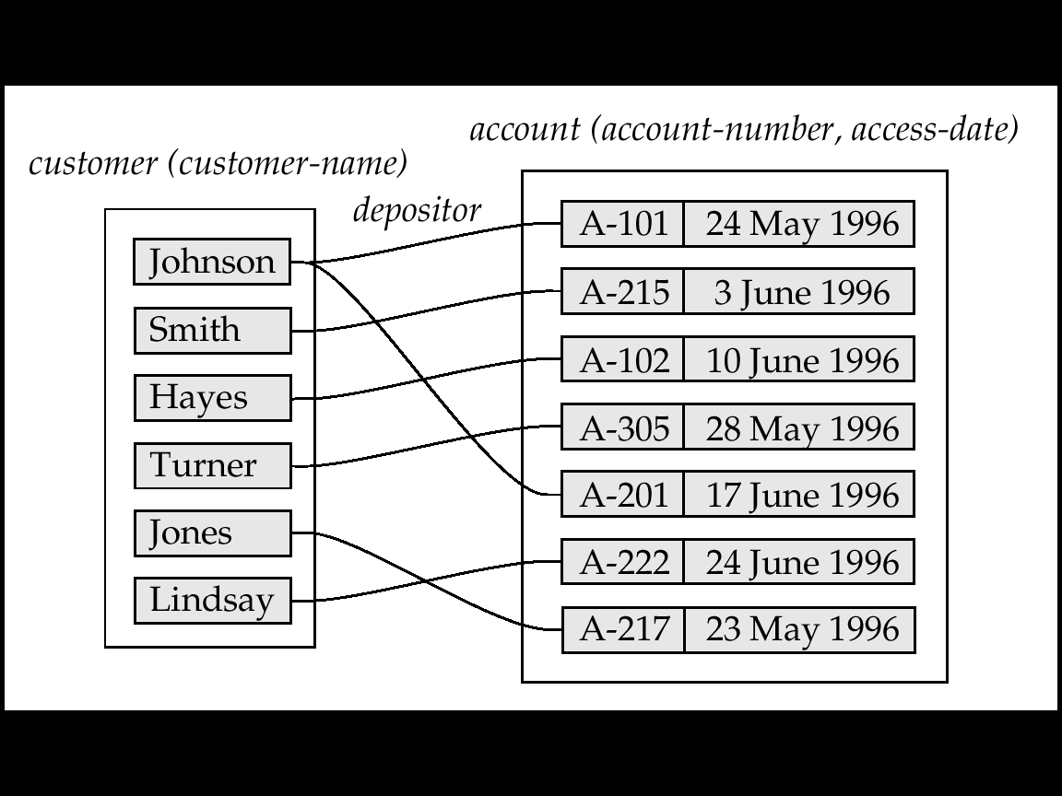
Mapping Cardinalities affect ER Design
Can make access-date an attribute of account, instead of a relationship attribute, if each account can have only one customer
I.e., the relationship from account to customer is many to one, or equivalently, customer to account is one to many

Slide 14
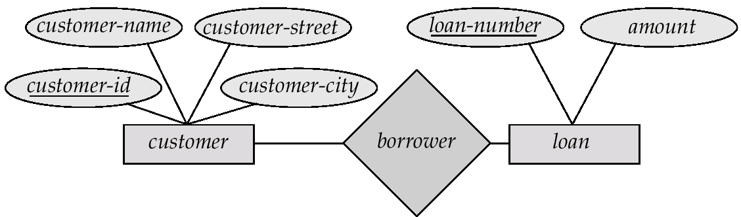
E-R Diagrams
Rectangles represent entity sets.
Diamonds represent relationship sets.
Lines link attributes to entity sets and entity sets to relationship sets.
Ellipses represent attributes
Double ellipses represent multivalued attributes.
Dashed ellipses denote derived attributes.
Underline indicates primary key attributes (will study later)

Slide 15
E-R Diagram With Composite, Multivalued, and Derived Attributes
street-name
middle-initial
street-number
apartment-number
first-name
last-name
street
city
name
address
state
customer-id
customer
zip-code
phone-number
date-birth
age

Slide 16
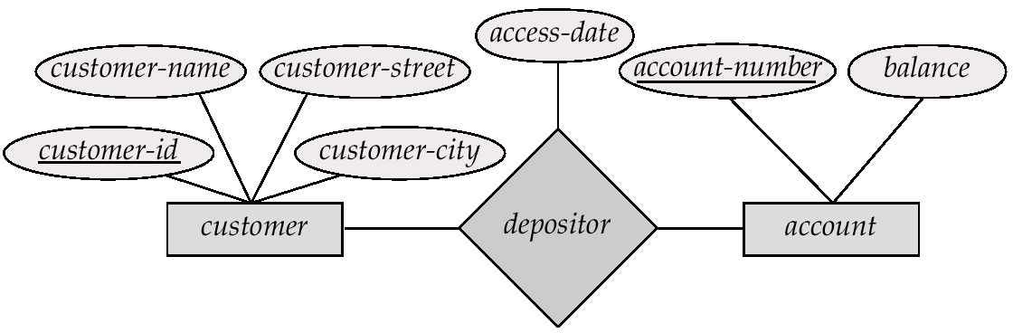
Relationship Sets with Attributes
access-date is called descriptive attribute
Represent the most recent a customer accessed an account.

Slide 17
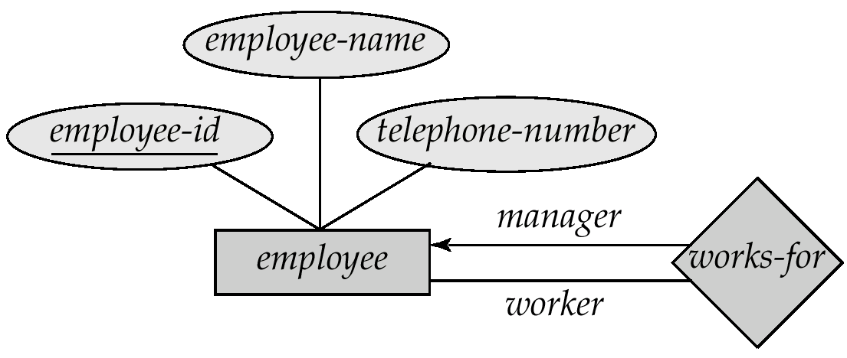
Roles
Entity sets of a relationship need not be distinct.
Needs role to indicate the function of entity in a relationship.
Example: labels “manager” and “worker” are called roles; specify how employee entities interact via the works-for relationship set.
Roles are indicated in E-R diagrams by labeling the lines that connect diamonds to rectangles.
Role labels are optional, and are used to clarify semantics of the relationship

Slide 18
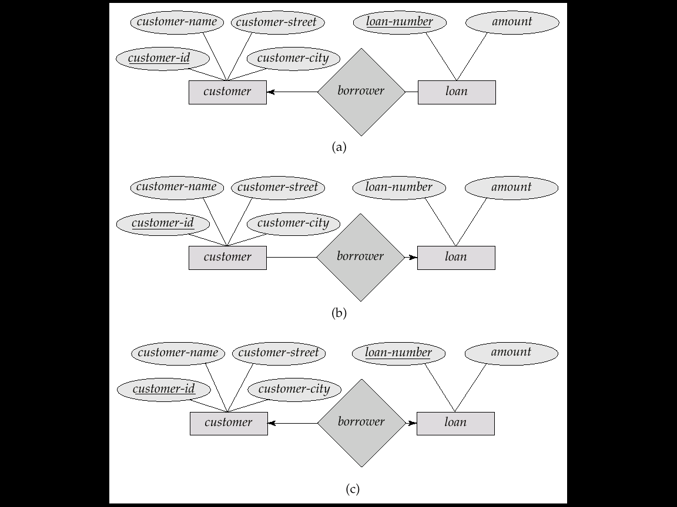
Cardinality Constraints
We express cardinality constraints by drawing either a directed line (→), signifying “one,” or an undirected line (—), signifying “many,” between the relationship set and the entity set.
E.g.: One-to-one relationship:
A customer is associated with at most one loan via the relationship borrower
A loan is associated with at most one customer via borrower

Slide 19
One-To-Many Relationship
In the one-to-many relationship a loan is associated with at most one customer via borrower, a customer is associated with several (including 0) loans via borrower

Slide 20
Many-To-One Relationships
In a many-to-one relationship a loan is associated with several (including 0) customers via borrower, a customer is associated with at most one loan via borrower

Slide 21
Many-To-Many Relationship
A customer is associated with several (possibly 0) loans via borrower
A loan is associated with several (possibly 0) customers via borrower

Slide 22
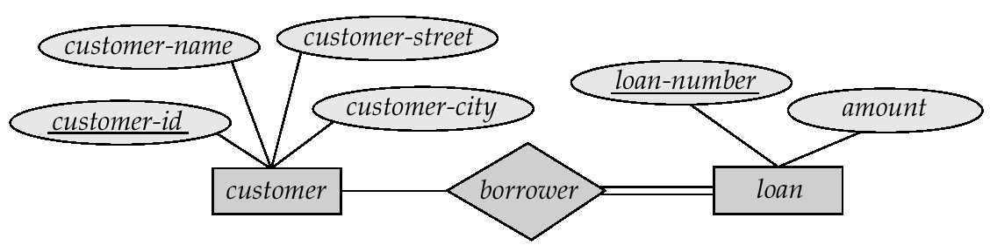
Participation of an Entity Set in a Relationship Set
Total participation (indicated by double line): every entity in the entity set participates in at least one relationship in the relationship set
E.g. participation of loan in borrower is total
every loan must have a customer associated to it via borrower
Partial participation: some entities may not participate in any relationship in the relationship set
E.g. participation of customer in borrower is partial

Slide 23
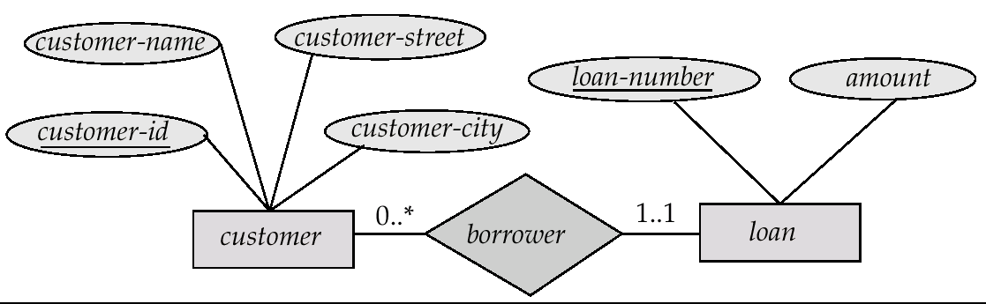
Alternative Notation for Cardinality Limits
Cardinality limits can also express participation constraints

Slide 24
Weak Entity Sets
An entity set that does not have a primary key is referred to as a weak entity set.
The existence of a weak entity set depends on the existence of a identifying entity set
It must relate to the identifying entity set via a total, one-to-many relationship set from the identifying to the weak entity set
Identifying relationship depicted using a double diamond
The discriminator (or partial key) of a weak entity set is the set of attributes that distinguishes among all the entities of a weak entity set.
The primary key of a weak entity set is formed by:
Primary key of the strong (identifying) entity set on which the weak entity set is existence.
The weak entity set’s discriminator.
Notes:
Weak entity set → does not have sufficient attribute to form primary key.
Strong (or identifying or owner) entity set → have a primary key.
Weak entity set – must be associated with identifying entity set. Called existence dependence on the identifying entity set.
Identifying relationship associates weak entity set with identifying entity set.
Participation of the weak entity set in the relationship is total.

Slide 25
Weak Entity Sets (Cont.)
We depict a weak entity set by double rectangles.
We underline the discriminator of a weak entity set with a dashed line.
payment-number – discriminator of the payment entity set
payment-number – typically sequential numbers, generated separately for each loan
Primary key for payment – (loan-number, payment-number)
→ shared between different loans
Strong or
identifying entity set →
← Weak entity set
Identifying relationship →
Notes:
In some cases, one may choose to express weak entity set as a multivalued composite attibute of the owner entity set.
E.g. payment is a multivalue composite attribute in loan, consisting payment-number, payment-date, payment-amount.
If a weak entity set participates in only the identifying relationship, and has few attributes → model as attribute.
If a weak entity set participates in relationships other than identifying relationship, and have several attributes → model as weak entity set.

Slide 26
Weak Entity Sets (Cont.)
Note: the primary key of the strong entity set is not explicitly stored with the weak entity set, since it is implicit in the identifying relationship.
If loan-number were explicitly stored, payment could be made a strong entity, but then the relationship between payment and loan would be duplicated by an implicit relationship defined by the attribute loan-number common to payment and loan
Notes:
A weak entity set may have different nature:
Can participate in relationships other than the identifying relationship. E.g.:
Payment entity could participate in a relationship with the account entity set → identify the account from which the payment was made.
May participate as owner in an identifying relationship with another weak entity set.
May have more than one identifying entity set → identified by combination of entities, one from each identifying entity set. The primary key of weak entity set would consist of:
The union of the primary keys of the identifying entity sets.
Discriminator of the weak entity set.

Slide 27
More Weak Entity Set Examples
In a university, a course is a strong entity and a course-offering can be modeled as a weak entity
The discriminator of course-offering would be semester (including year) and section-number (if there is more than one section)
If we model course-offering as a strong entity we would model course-number as an attribute. Then the relationship with course would be implicit in the course-number attribute

Slide 28
Exercise:
Prodia Laboratorium needs a system to manage its Client. Every Client has ClientId, Name, Address, BirthDate, ContactNo and EmailAddress.
Anytime Client visited the lab, he/she will be served by a staff to note all requirements and create the invoice. After payment is done, a Paramedic will take the Client’s blood for examination.
The result will be sent by email to the Client.
Create an ER model for the above situation.

Slide 29
Keys
A super key of an entity set is a set of one or more attributes whose values uniquely determine each entity.
A candidate key of an entity set is a minimal super key
customer-id is candidate key of customer
account-number is candidate key of account
Although several candidate keys may exist, one of the candidate keys is selected to be the primary key.

Slide 30
Keys for Relationship Sets
The combination of primary keys of the participating entity sets forms a super key of a relationship set.
(customer-id, account-number) is the super key of depositor
NOTE: this means a pair of entity sets can have at most one relationship in a particular relationship set.
E.g. if we wish to track all access-dates to each account by each customer, we cannot assume a relationship for each access. We can use a multivalued attribute though
Must consider the mapping cardinality of the relationship set when deciding what are the candidate keys
Need to consider semantics of relationship set in selecting the primary key in case of more than one candidate key

Slide 31
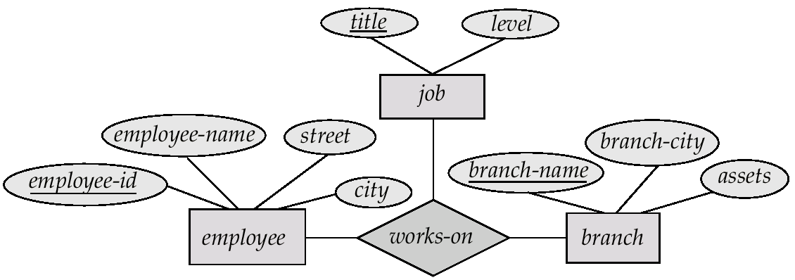
E-R Diagram with a Ternary Relationship
E.g. Suppose employees of a bank may have jobs (responsibilities) at multiple branches, with different jobs at different branches. Then there is a ternary relationship set between entity sets employee, job and branch

Slide 32
Cardinality Constraints on Ternary Relationship
We allow at most one arrow out of a ternary (or greater degree) relationship to indicate a cardinality constraint
E.g. an arrow from works-on to job indicates each employee works on at most one job at any branch.
If there is more than one arrow, there are two ways of defining the meaning.
E.g a ternary relationship R between A, B and C with arrows to B and C could mean
each A entity is associated with a unique entity from B and C or
each pair of entities from (A, B) is associated with a unique C entity, and each pair (A, C) is associated with a unique B
Each alternative has been used in different formalisms
To avoid confusion we outlaw more than one arrow

Slide 33
Binary Vs. Non-Binary Relationships
Some relationships that appear to be non-binary may be better represented using binary relationships
E.g. A ternary relationship parents, relating a child to his/her father and mother, is best replaced by two binary relationships, father and mother
Using two binary relationships allows partial information (e.g. only mother being know)
But there are some relationships that are naturally non-binary
E.g. works-on

Slide 34
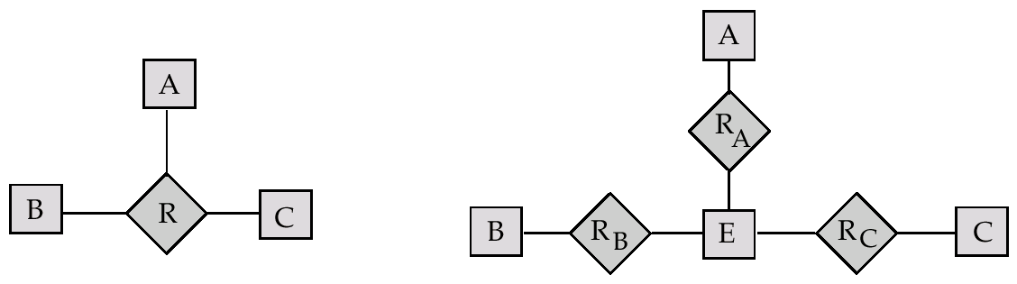
Converting Non-Binary Relationships to Binary Form
In general, any non-binary relationship can be represented using binary relationships by creating an artificial entity set.
Replace R between entity sets A, B and C by an entity set E, and three relationship sets:
1. R_{A}, relating E and A 2. R_{B}, relating E and B
3. R_{C}, relating E and C
Create a special identifying attribute for E
Add any attributes of R to E
For each relationship (a_{i} , b_{i} , c_{i}) in R, create
1. a new entity e_{i} in the entity set E 2. add (e_{i} , a_{i} ) to R_{A}
3. add (e_{i} , b_{i} ) to R_{B} 4. add (e_{i} , c_{i} ) to R_{C}

Slide 35
Converting Non-Binary Relationships (Cont.)
Also need to translate constraints
Translating all constraints may not be possible
There may be instances in the translated schema that cannot correspond to any instance of R
Exercise: add constraints to the relationships R_{A}, R_{B} and R_{C} to ensure that a newly created entity corresponds to exactly one entity in each of entity sets A, B and C

Slide 36
Specialization
Top-down design process; we designate subgroupings within an entity set that are distinctive from other entities in the set.
These subgroupings become lower-level entity sets that have attributes or participate in relationships that do not apply to the higher-level entity set.
Depicted by a triangle component labeled ISA (E.g. customer “is a” person).
Attribute inheritance – a lower-level entity set inherits all the attributes and relationship participation of the higher-level entity set to which it is linked.

Slide 37
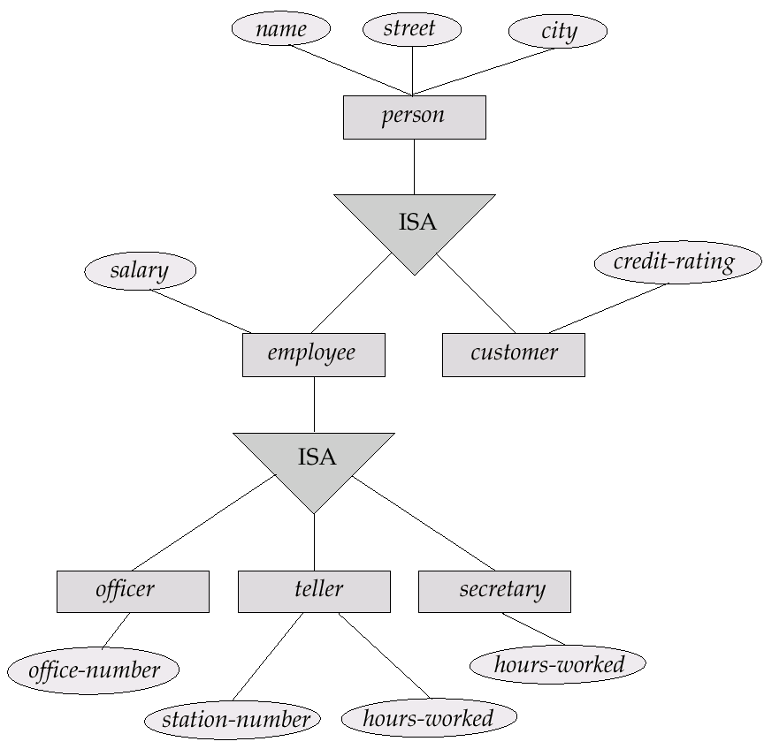
Specialization Example
Notes:
A crucial property of the higher- and lower-level entities is attribute inheritance.
E.g. customer and employee inherit the attributes of person.
customer described by name, street, city plus customer-id and credit-rating.
employee described by name, street, city plus employee-id and salary.

Slide 38
Generalization
A bottom-up design process – combine a number of entity sets that share the same features into a higher-level entity set.
Specialization and generalization are simple inversions of each other; they are represented in an E-R diagram in the same way.
The terms specialization and generalization are used interchangeably.

Slide 39
Specialization and Generalization (Cont.)
Can have multiple specializations of an entity set based on different features.
E.g. permanent-employee vs. temporary-employee, in addition to officer vs. secretary vs. teller
Each particular employee would be
a member of one of permanent-employee or temporary-employee,
and also a member of one of officer, secretary, or teller
The ISA relationship also referred to as superclass - subclass relationship

Slide 40
Design Constraints on a Specialization/Generalization
Constraint on which entities can be members of a given lower-level entity set.
condition-defined
E.g. all customers over 65 years are members of senior-citizen entity set; senior-citizen ISA person.
user-defined
Constraint on whether or not entities may belong to more than one lower-level entity set within a single generalization.
Disjoint
an entity can belong to only one lower-level entity set
Noted in E-R diagram by writing disjoint next to the ISA triangle
Overlapping
an entity can belong to more than one lower-level entity set

Slide 41
Design Constraints on a Specialization/Generalization (Contd.)
Completeness constraint – specifies whether or not an entity in the higher-level entity set must belong to at least one of the lower-level entity sets within a generalization.
total : an entity must belong to one of the lower-level entity sets
partial: an entity need not belong to one of the lower-level entity sets

Slide 42
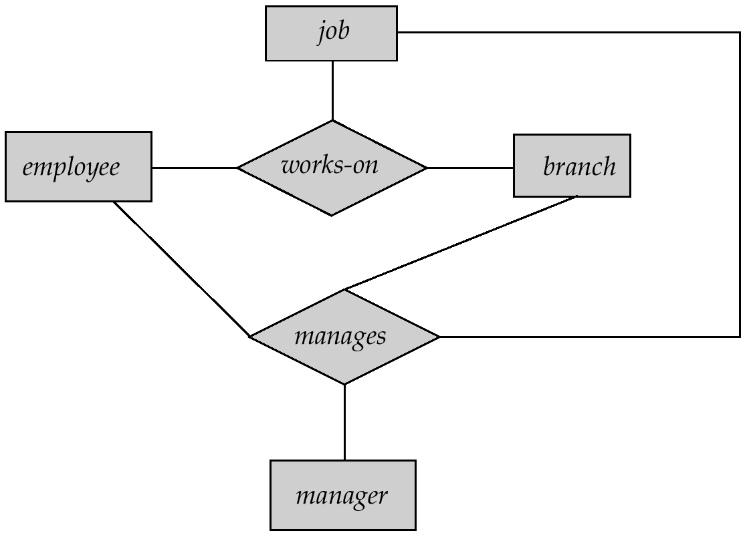
Aggregation
Consider the ternary relationship works-on, which we saw earlier
Suppose we want to record managers for tasks performed by an employee at a branch

Slide 43
Aggregation (Cont.)
Relationship sets works-on and manages represent overlapping information
Every manages relationship corresponds to a works-on relationship
However, some works-on relationships may not correspond to any manages relationships
So we can’t discard the works-on relationship
Eliminate this redundancy via aggregation
Treat relationship as an abstract entity
Allows relationships between relationships
Abstraction of relationship into new entity
Without introducing redundancy, the following diagram represents:
An employee works on a particular job at a particular branch
An employee, branch, job combination may have an associated manager

Slide 44
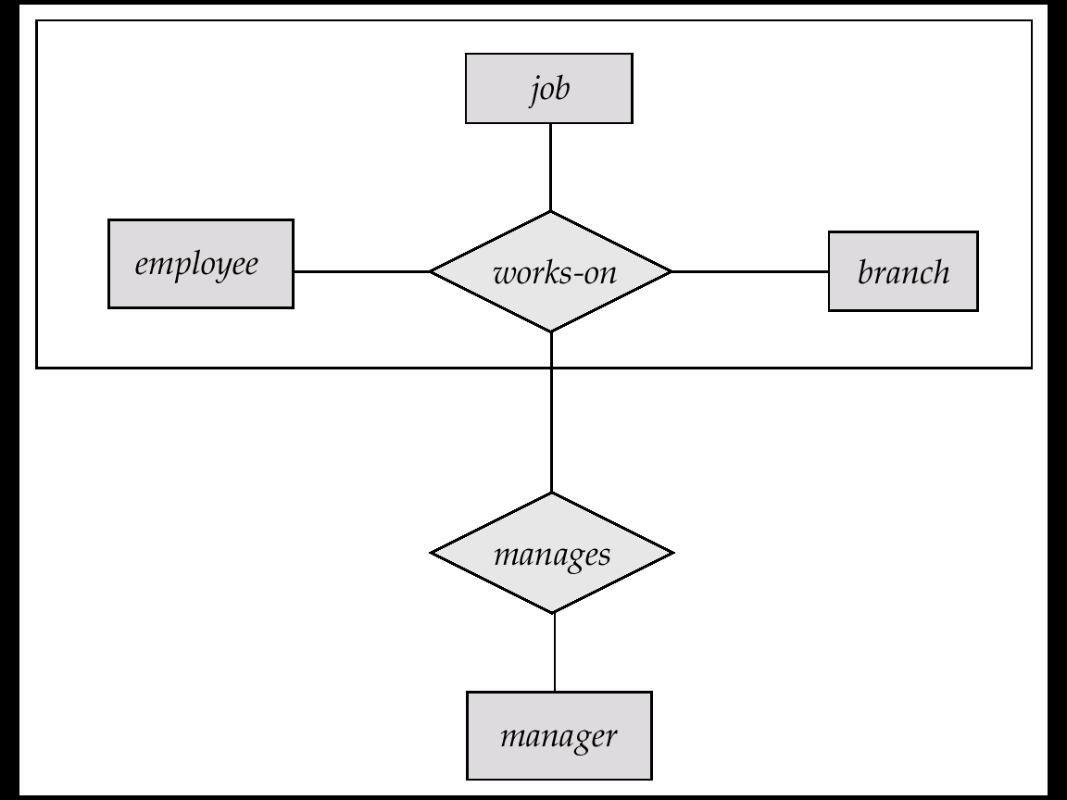
E-R Diagram With Aggregation

Slide 45
E-R Design Decisions
The use of an attribute or entity set to represent an object.
Whether a real-world concept is best expressed by an entity set or a relationship set.
The use of a ternary relationship versus a pair of binary relationships.
The use of a strong or weak entity set.
The use of specialization/generalization – contributes to modularity in the design.
The use of aggregation – can treat the aggregate entity set as a single unit without concern for the details of its internal structure.

Slide 46
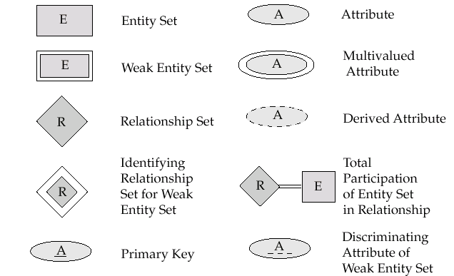
Summary of Symbols Used in E-R Notation

Slide 47
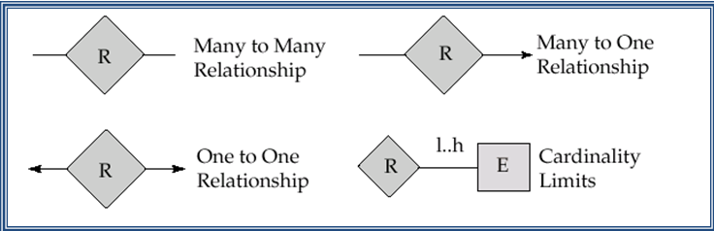
Summary of Symbols (Cont.)

Slide 48
Design Issues
Use of entity sets vs. attributes Choice mainly depends on the structure of the enterprise being modeled, and on the semantics associated with the attribute in question.
Use of entity sets vs. relationship sets Possible guideline is to designate a relationship set to describe an action that occurs between entities
Binary versus n-ary relationship sets Although it is possible to replace any nonbinary (n-ary, for n > 2) relationship set by a number of distinct binary relationship sets, a n-ary relationship set shows more clearly that several entities participate in a single relationship.
Placement of relationship attributes

Slide 49
Case study for a Banking Enterprise
The information system to be developed for the Bank should manage preferred customer data and the Customer Service (CS) assigned to the specific customer. Every preferred customer will be taken care of by one CS.
Customer may have accounts, either saving accounts or checking accounts. On saving accounts, customer may receive monthly interest depend on the agreed rate. On checking accounts, customer may have overdraft on an agreed amount.

Slide 50
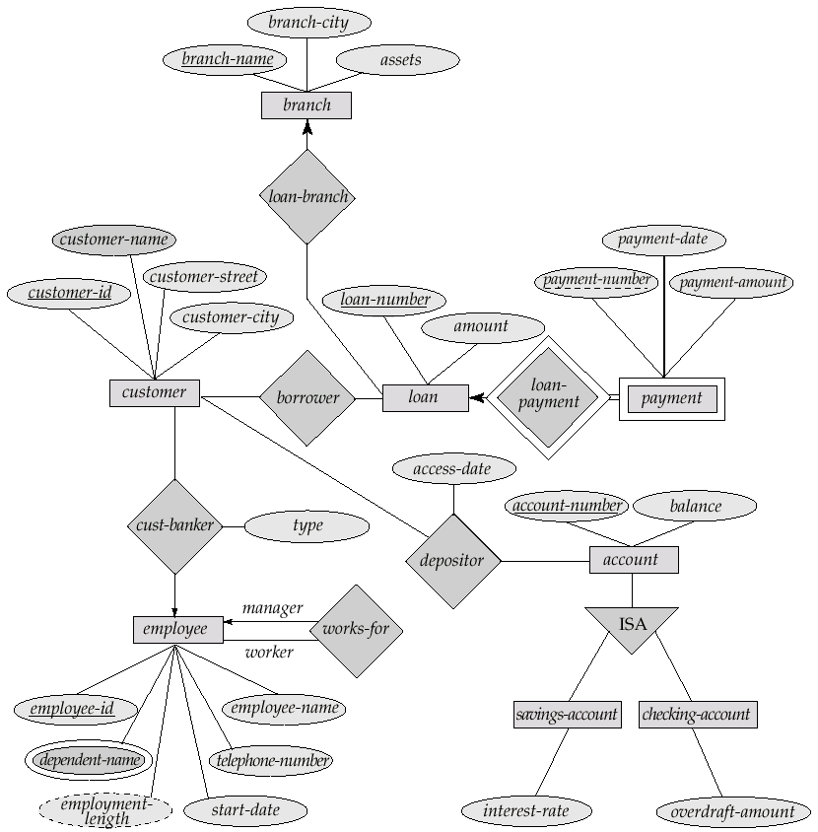
E-R Diagram for the case study

